Slide 1
Stroke Prediction
Ascendpro
Hackathon – 1
By
Sai Venkatesh

Slide 2
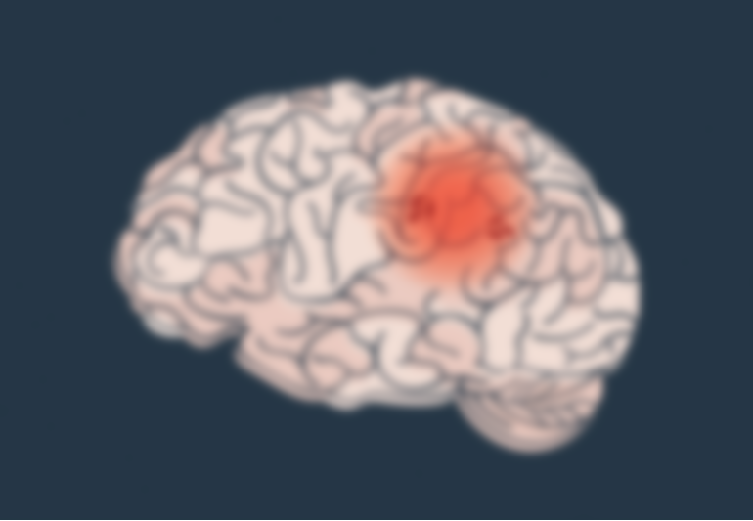
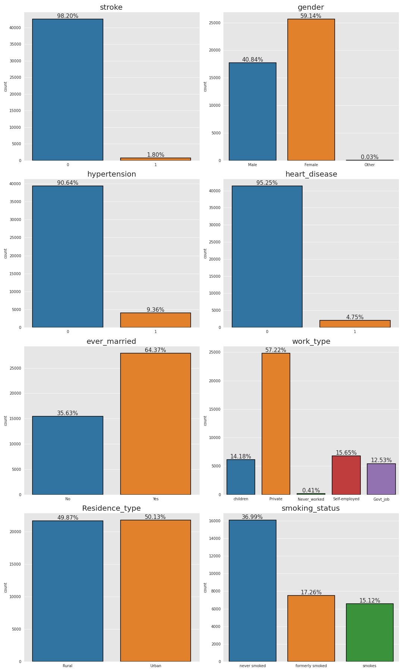
Exploratory Data Analysis
Univariate analysis - Categorical
In the given training set we see that there are only
1.8% cases of stroke. This is a highly imbalanced
Dataset and need to dealt by optimizing parameters
The female population in dataset(59.14%) is higher
than the male population (40.84%) and there is another Category ‘other’ whose population is very low

Slide 3
Univariate analysis – Categorical variable
Population with hypertension are 9.36 % of the
given dataset. As per our hypothesis and reference, people with hypertension have more chance of stroke and we will check this during bivariable EDA
Population with heart disease are 4.75 % of the
given dataset. As per our hypothesis and reference, people with heart disease have more chance of stroke and we will check this during bivariable EDA

Slide 4
Univariate analysis – Categorical variable
Here we have 5 types of work categories and among them private sector is most and never worked is least and we see how this effects the chance of stroke occurrence during bivariate EDA
64.37 % of given population are married. Marriage is related to age and elder people are more likely to be married.

Slide 5
Univariate analysis – Categorical variable
We have three categories regarding smoking and people who have never smoked are more in our dataset and as per our hypothesis smoking increases the chance of having a stroke
The given population are evenly distributed among the Rural and Urban type and this not affect our final prediction.

Slide 6
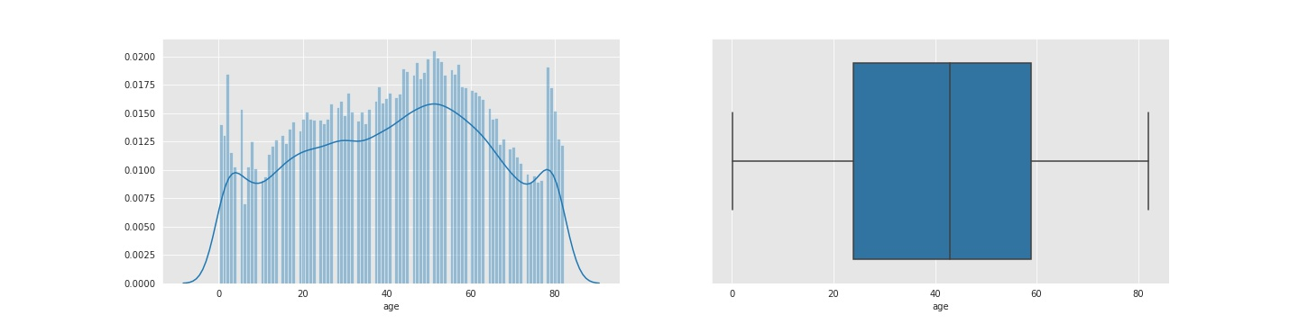
Univariate analysis – Continuous variable - Age
The age of the given population is evenly distributed in the age group of 0 to 80. We find there are many people under the age of 1 in the given dataset. They are newborn children and they don’t get a stroke . So, we will only consider the people above the age of 1 for our evaluation

Slide 7
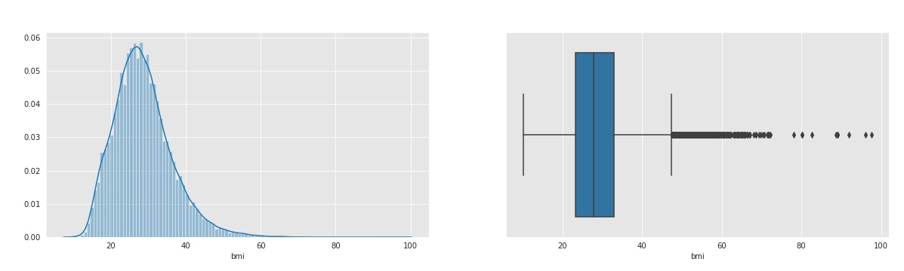
Univariate analysis – Continuous variable - BMI
Here there are many outliers and they need to be treated. BMI values above 60 are extremely rare and they can be removed from our dataset. This won't affect our prediction as our assumption is realistic
The number of values greater than 60 are 89 or (89/43311 = 0.002%) which is very small so they can be removed

Slide 8
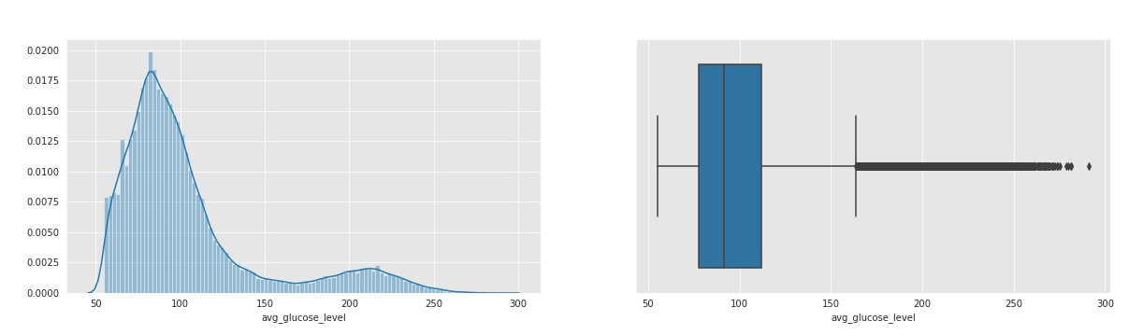
Univariate analysis – Continuous variable – Glucose levels
Here we observe a bimodal distribution and also average glucose levels above 200 are extremely rare so we will only consider the value below 200 for our model building

Slide 9
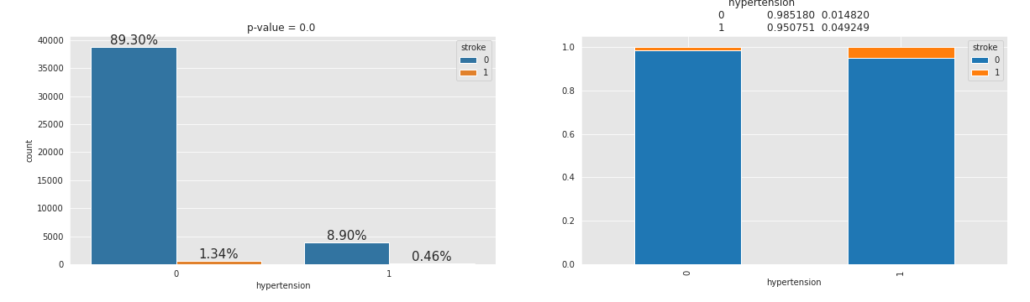
Bivariate analysis – Hypertension vs stroke
People with hypertension have more chance of getting a stroke and it is evident from the stacked plot where 4.9% of people with hypertension got a stroke and only 1.4% of people without hypertension have a stroke.
Also p- value is less than 0.05 which implies this is a significant variable for prediction

Slide 10
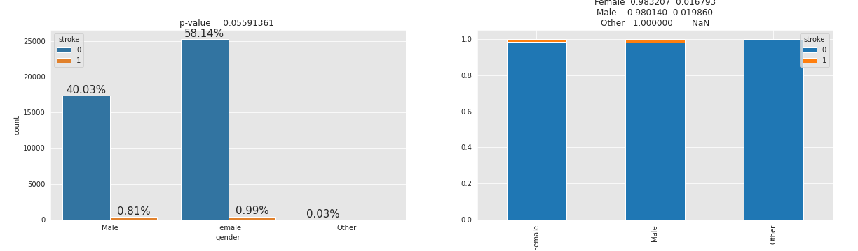
Bivariate analysis – Gender vs stroke
It appears males have a greater chance of getting a stroke than females but the difference is insignificant (1.9% male vs 1.6% female). Also the p-value is greater than our alpha indicating not a significant variable for prediction , so we will drop it.

Slide 11
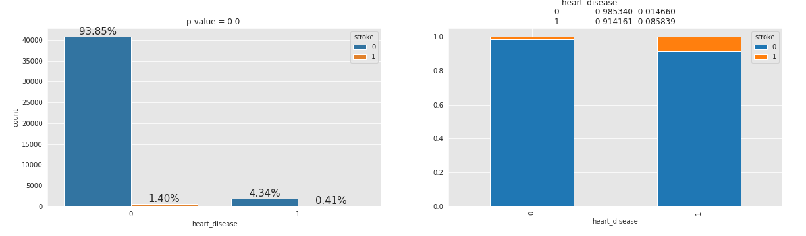
Bivariate analysis – Heart disease vs stroke
Here the plots clearly indicate that people with heart disease have more chance of getting a stroke shown by 8.5% with heart disease got a stroke but only 1.4% without heart disease got a stroke
This fact is also evident from p-value which is below 0.05

Slide 12
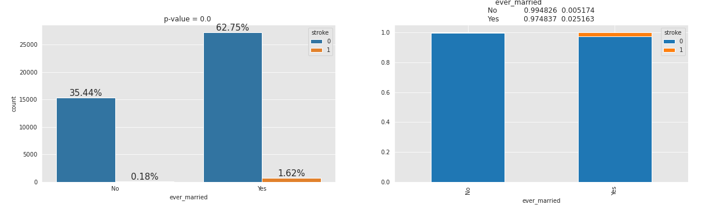
Bivariate analysis – Marriage status vs stroke
From the plot it indicates people who are married have more chance of stroke. It is evident from the fact that most of the time married people are higher in age than unmarried , so the reason for stroke is due to increase in age but not directly related to marriage.

Slide 13
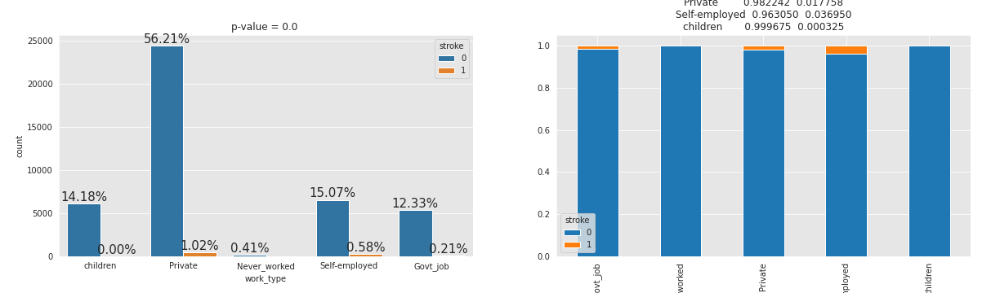
Bivariate analysis –Work Type vs stroke
Here never worked mostly come under children category so these two categories have low chance of stroke.
But employed people have higher chances of stroke reasons being work pressure and a stressed life. Here an interesting observation is self employed people have greater chance of getting a stroke. This can intuitively thought as they have more burden of looking at their business leading to elevated stress levels.

Slide 14
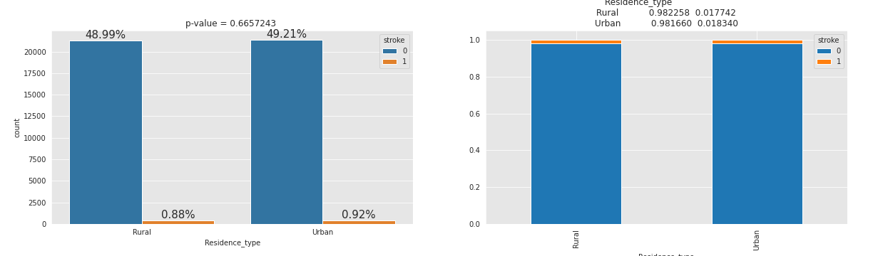
Bivariate analysis –Residence Type vs stroke
People with and without stroke are evenly distributed among the population. So we can say that this is not a significant variable for our final prediction so we will drop this. This fact is also evident from p-value of 0.66 which is far greater than our alpha 0.05

Slide 15
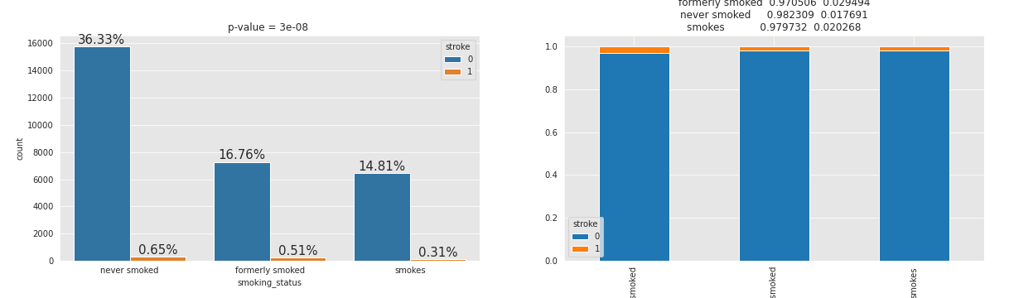
Bivariate analysis –Smoking behavior vs stroke
The plot clearly indicates that people who used to smoke or who currently smoke have a greater chance of getting a stroke. This is also validated by our reference. Also the p-value is less than alpha indicating this is a significant variable for our prediction

Slide 16
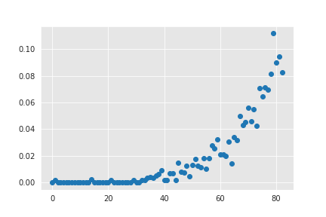
Bivariate analysis –Age vs stroke
The plot clearly indicates that increase in age exponentially increases the risk of having a stroke
Also note that below the age of 30, the risk of stroke is almost certainly 0
We will be considering only people above age 1 for our modelling as explained in univariate age analysis

Slide 17
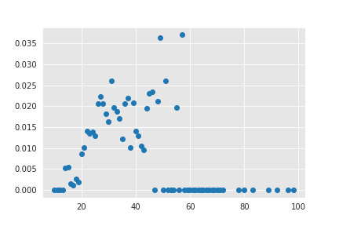
Bivariate analysis –BMI vs stroke
The plot clearly indicates that with an increase in BMI values increases the risk of having a stroke.
Also as per our univariable analysis there are many outliers and BMI values above 60 are extremely rare so we consider only people with BMI less than 60 for our modelling

Slide 18
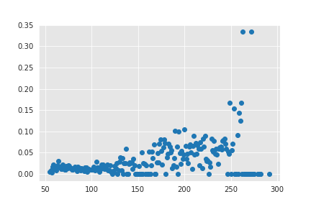
Bivariate analysis –Glucose levels vs stroke
The plot indicates that with an increase in average glucose levels in the body there is an increased risk of having a stroke.
Also as per our univariable analysis there are many outliers and glucose levels above 200 are extremely rare so we consider only people with glucose level less than 200 for our modelling

Slide 19
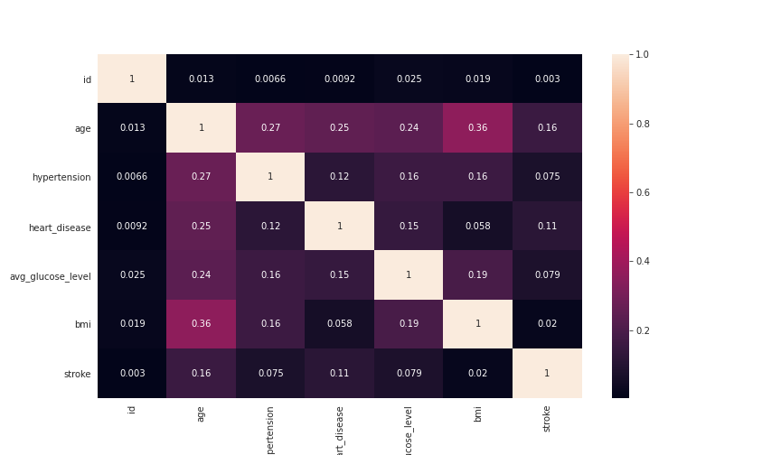
Person Correlation matrix

Slide 20
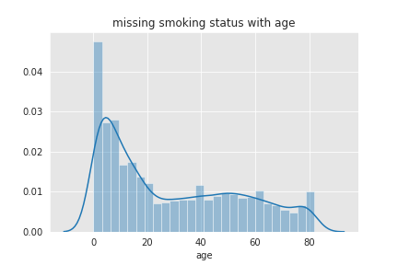
Data Manipulation
Missing Data Imputation
There are 1462 missing BMI values in train set
13292 missing smoking status in train set
591 missing BMI values in test set
5751 missing smoking status in test set
For BMI:
We impute the missing values with median and consider only values below 60 for model building
For Average Glucose level:
We consider only values below 200 for our model building
From results of Exploratory data analysis we wont be considering Residence type, gender and marriage status for our model building
For Smoking Status :
From the graph it is evident that most of the missing smoke status are in ages less than 20, they can be children and teenagers. So we will impute the missing values with never smoked status

Slide 21
Data Modelling
1. Feature Scaling
Standard Scaler is used to scale the continuous features
For Categorical features values were assigned depending on the importance by results from EDA
2. Model Building
Train test spit from sklearn
model = LogisticRegression(class_weight='balanced', fit_intercept= True, penalty= 'l2',random_state=11)
Accuracy Score: 0.734578024473319
Area Under Curve: 0.8486496397511386
Recall score: 0.8292682926829268
brier_score :0.17309085667987517

